Slide 1
MEASUREMENT OF PRESSURE

Slide 2
Why to measure?
The measurement of pressure and vacuum has always been important in continuous and most of the processing industries.
In a surprising number of chemical applications, pressure measurement is more important and is easier to perform than temperature measurement.
In many operations it is necessary to measure and control pressure of liquid or gas to avoid any hazards.
Hence pressure measurement is one of the most important of all process measurements

Slide 3
Definition and Units
Pressure is defined as the amount of force applied per unit surface area on which it acts normally
Units of Pressure: From the definition of pressure, its units can be derived as-
Newton per square meter(N/m² )
Pascal(Pa)
Atmosphere or bar units (atm ,bar)
Pounds per square inch (psi)
Micron
Torr
Head units- in mm of mercury or water or any
other liquid.

Slide 4
Conversion
1Pascal(1N/m²) = 10 dyne/cm²
1mmHg = 133.32 pascals = 13.595 mm Water
Standard atmosphere = 1.013 * 10⁵N/m²
1 millibar = 1000 dyne/cm²
1 micron = 10⁻⁶mHg
1 torr = 1 mmHg = 1000micron

Slide 5
Atmospheric pressure (P_{atm})
The pressure due to the air surrounding the earth surface is called the atmospheric pressure.
Units- Pa, Psi, mm.Hg
Absolute Pressure (P_{ab})
The pressure measured above absolute zero pressure is called absolute pressure.
Absolute pressure = Gauge pressure + Atm.Pressure.
Units- Microns, mm.Hg

Slide 6
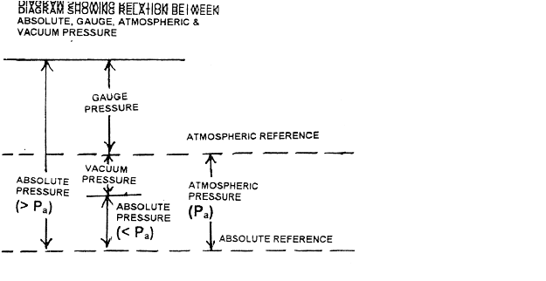

Slide 7
Gauge Pressure (P_{g})
The pressure measured is greater than atmospheric pressure, is called gauge pressure.
Vacuum Pressure
The pressure measured is less than the atm. Pressure at a point is called a vacuum pressure. Units- mm.Hg.

Slide 8
Methods of Pressure Measurement
Most pressure instruments measure a difference between two pressures, one usually being that of the atmosphere. The different methods of pressure measurement are listed below.
Manometer method
Elastic pressure transducers
Pressure measurement by measuring vacuum
Pressure measurement by balancing the force produced on a known area by a measured force
Electrical pressure transducers

Slide 9
List of Instruments used to measure pressure
1. Gravitational Transducers
a. A dead weight tester
b. Manometer
2. Elastic Pressure Transducers
a. Bourdon tube pressure gauge
C-Type pressure gauge
Helical pressure gauge
Spiral pressure gauge
b. Elastic Diaphragm gauge
c. Bellows gauges
Bellows gauge to measure gauge pressure
Bellows gauge to measure differential pressure

Slide 10
3. Electrical Pressure Transducers
Strain Gauge Pressure Transducers
Potentiometric Pressure Transducers
4. McLeod vacuum gauge
5. Thermal conductivity gauges
Pirani gauge
Thermocouple type conductivity gauge
6. Ionization gauge.

Slide 11
Pressure measuring instruments and types of pressure to be measured
Manometer Low pressure
Bourdon tube pressure gauge
Diaphragm gauge High and medium pressure
Bellows gauge
McLeod vacuum gauge
Thermal conductivity gauge Low vacuum and
Ionization gauge ultra high vacuum

Slide 12
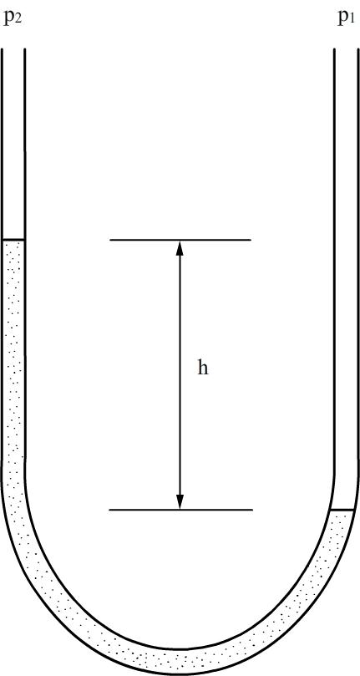
Liquid column manometers

Slide 13
Liquid column manometers
Liquid column consists of a column of liquid in a tube whose ends are exposed to different pressures
The column will rise or fall until its weight is in equilibrium with the pressure differential between the ends of the tube
A very simple version is a U – shaped tube half full of liquid, one side of which is connected to the region of interest while the reference pressure is applied to the other

Slide 14
The difference in the liquid level represents the applied pressure
The pressure exerted by a column of fluid of height ‘h’ and density ‘ρ’ is given by the hydrostatic pressure equation
P = hgρ (or)
P₁-P₂ = (g/g_{c}) h (ρ_{A} - ρ_{B})
ρ_{A} ₋ density of manometer fluid
ρ_{B} ₋ density of fluid filled above the manometer fluid

Slide 15
Commonly used manometric liquids are mercury, water or alcohol.
Important and desirable properties of the manometric liquids are:
High chemical stability
Low viscosity
Low coefficient of thermal expansion
Low volatility

Slide 16
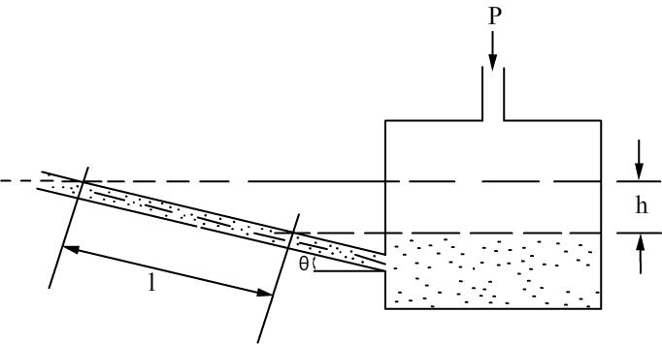
Inclined manometer

Slide 17
Here the pressure difference is given by
P₁-P₂ = (g/g_{c}) h (ρ_{A} - ρ_{B}) sin θ

Slide 18
Bourdon tube pressure gauge
According to bourdon theory, a tube having internal cross-section that is not a perfect circle if bent or distorted, has the property of changing its shape with internal pressure variation.
This causes the free end to deflection of the tube which can be taken as the measure of change in pressure inside it.

Slide 19
Bourdon tube pressure gauge
The bourdon pressure gauge use different type of bourdon springs.
They are
C-Type pressure gauge
Helical pressure gauge
Spiral pressure gauge

Slide 20
Bourdon tube pressure gauge
Materials of construction
Brass
Alloy steel
Stainless steel
Bronze
Phosphor Bronze
Monel

Slide 21
C-Type Bourdon tube pressure gauge
Principle
When an elastic transducer (bourdon tube) is subjected to a pressure, it deflects. This deflection is proportional to the applied pressure when calibrated.

Slide 22
C-Type Bourdon tube pressure gauge
Construction
The bourdon tube is in a bent form to look like a circular arc, having arc length of about 270º.
The cross- section of the bourdon tube is elliptical.
Diameter of dial ranges from 2 inch diameter to 14 inch diameter.
Bourdon tube which is fixed at one end and open at other end to receive the pressure which is to be measured.
The other end of the bourdon tube is free and closed.

Slide 23
C-Type Bourdon tube pressure gauge
To the free end of the bourdon tube is attached an adjustable link which is intern connected to a sector and pinion as shown in figure.
To the shaft of the pinion is connected a pointer which sweeps over a pressure calibrated scale.

Slide 24
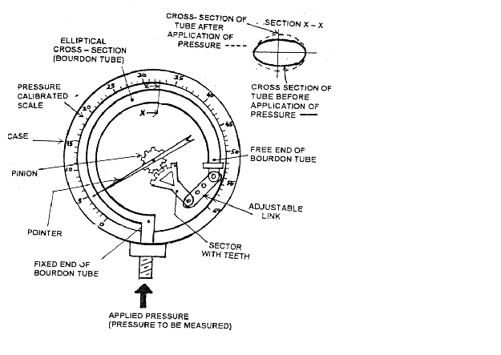

Slide 25
C-Type Bourdon tube pressure gauge
Working
The pressure to be measured is connected to the fixed, open end of the bourdon tube.
The applied pressure acts on the inner walls of the bourdon tube.
Due to the applied pressure the bourdon tube tends to change in cross-section from elliptical to circular.
This tends to straighten the bourdon tube causing a displacement of the free closed end of the bourdon tube

Slide 26
C-Type Bourdon tube pressure gauge
This displacement of the free closed end of the bourdon tube is proportional to the applied pressure.
As the free end of the bourdon tube is connected to a adjustable link- pinion arrangement, the displacement is amplified and connected to a rotary motion of the pinion.
As the pinion rotates, it makes the pointer to assume a new position on a pressure calibrated scale to indicate the applied pressure directly.

Slide 27
C-Type Bourdon tube pressure gauge
Applications
They are used to measure medium to very high pressure.
For the measurement of pressure 20000 PSi or less.
Used to measure gauge pressure or vacuum.
This type is used literally by the thousands in all industries.
Compressed gas regulators.
Used in chemical, petrochemical industries, power stations, mining, environmental technology etc.

Slide 28
C-Type Bourdon tube pressure gauge
Advantages
Low cost and simple in construction.
They can be modified to give electrical outputs.
High accuracy in relation to low cost.
Wide pressure range.
They are safe even for high pressure measurement.
Disadvantages
They respond slowly to change in pressure.
They are sensitive to shocks and vibrations.

Slide 29
Spiral type bourdon tube pressure gauge
Principle
When an elastic transducer (bourdon tube) is subjected to a pressure, it deflects. This deflection is proportional to the applied pressure when calibrated.

Slide 30
Spiral type bourdon tube pressure gauge
Construction and Working
A spiral tubes are made by winding several turns of the tubes with its flattened cross-section in the form of a spiral.
In spiral type bourdon tube, there is no need of geared sector and pinion arrangement.

Slide 31
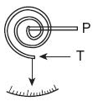

Slide 32
Spiral type bourdon tube pressure gauge
The absence of geared sector and pinion arrangements eliminates the backlash which tends to occur when they are used continuously.
When the pressure to be measured is applied to the spiral, it tends to uncoil, producing a relatively long movement of the tip whose displacement is used for indication.
An increased displacement of the free end can be obtained by increasing the number of turns in the spiral or helix.

Slide 33
Spiral type bourdon tube pressure gauge
Applications
Used in water pumps, air compressors, pump, medical oxygen equipment, fire extinguishers and other industries.

Slide 34
Spiral type bourdon tube pressure gauge
Advantages
Accuracy is higher than C-type bourdon tube pressure gauge.
Low cost and simple in construction.
Wide pressure range.
Disadvantages
They are sensitive to shocks and vibrations.
Low spring gradient.

Slide 35
Helical type bourdon tube pressure gauge
Principle
When an elastic transducer (bourdon tube) is subjected to a pressure, it deflects. This deflection is proportional to the applied pressure when calibrated.

Slide 36
Helical type bourdon tube pressure gauge
Construction and Working
In helical type, numbers of turns are wound in helix form as shown in figure.
Usually a central shaft is installed within a helical element and the pointer is driven from the shaft by connecting links.
The displacement at the tip of a helical element is larger than that of spiral element.
The number of coils employed in helix element depends upon the pressure to be measured.

Slide 37
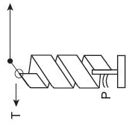

Slide 38
Helical type bourdon tube pressure gauge
For measuring low pressure three coils are used and for higher pressure more than sixteen coils are used.
This system transmits only the circular motion of the tip of the pointer which is directly proportional to the change in pressure.

Slide 39
Helical type bourdon tube pressure gauge
Advantages
Used to measure fluctuating pressure.
For measuring high pressure.
Accuracy is high.
Disadvantages
They are sensitive to shocks and vibrations.

Slide 40
Diaphragm Gauges
Principle
When a diaphragm is subjected to a pressure it deflects. This deflection is proportional to the applied pressure when calibrated.

Slide 41
Diaphragm Gauges
Construction
A diaphragm is a thin circular plate (made of springy material) is fixed firmly around its edges.
The diaphragm may be either flat or corrugated.
A corrugated diaphragm has been shown in the diagram where the displacement of the diaphragm is magnified by means of mechanical means.

Slide 42
Diaphragm Gauges
The top portion of the diaphragm is fixed with a boss of negligible weight.
This boss intern connected to a link-sector-pinion arrangement.
A pointer is connected to the pinion which makes it sweep over a pressure calibrated scale

Slide 43
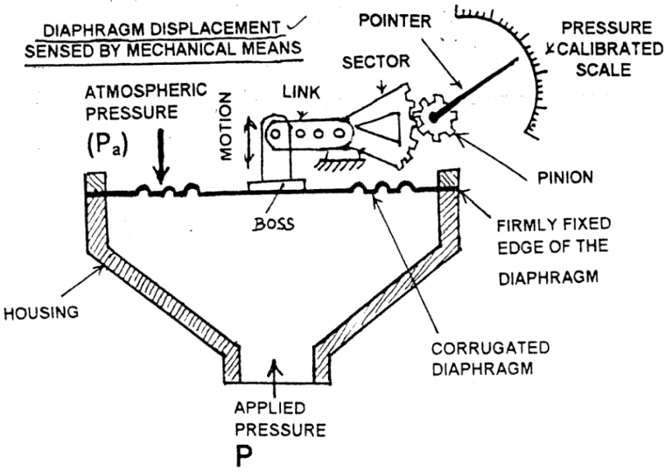

Slide 44
Diaphragm Gauges
Working
The bottom side of the diaphragm is exposed to the pressure which is to be measured.
Due to the applied pressure, the diaphragm deform i.e. the diaphragm tend to move upwards.
This deformation is magnified by the link-sector –pinion arrangement i.e. the linear displacement from the diaphragm is converted to a magnified rotary motion of the pinion

Slide 45
Diaphragm Gauges
When the pinion rotates it makes the pointer attached to it to assume to a new position on the pressure calibrated scale which becomes a measure of the applied pressure.
At the top side of the diaphragm is usually subjected to the atmospheric pressure (generally less than the applied pressure), diaphragm gauges usually read gauge pressure.

Slide 46
Diaphragm Gauges
Applications
They are used to measure medium pressure.
They can also be used to measure pressure up to 5 PSi.
They are used to measure draft in chimneys of boilers.
Used in chemical and petrochemical industries, Pulp and Paper industry, Electrical power plants, Food processing, Water and sewage treatment plants etc.

Slide 47
Diaphragm Gauges
Advantages
They cost less.
They can withstand over pressure and they are
safe to be used.
No permanent zero shift.
Disadvantages
They are sensitive to shocks and vibrations and hence they have to be protected.
When used to higher pressure measurement the diaphragm gets damage.
These gauges are difficult to repair.

Slide 48
Diaphragm Gauges
Diaphragm gauge materials of construction
The following metals are used to make Diaphragm gauge.
Brass
Stainless steel
Bronze
Monel
Inconel
Nickel
Beryllium copper

Slide 49
Diaphragm Gauges
The following non- metals are also used to make Diaphragm gauge
Nylon
Teflon
Buna N rubber
Leather
Thin Neoprene like material.

Slide 50
Bellows Gauges
Generally there are two types of Bellows gauges namely.
Bellows gauges to measure gauge pressure.
Bellows gauges to measure differential pressure.

Slide 51
Bellows gauges to measure gauge pressure
Principle
When bellows is subjected to a pressure it deflects. This deflection is proportional to the applied pressure when calibrated.

Slide 52
Bellows gauges to measure gauge pressure
Construction
A Bellows whose one end is fixed and opened to receive the applied pressure.
The other end of the Bellows is closed and attached to a rod externally.
A spring is placed inside the bellows.
To the rod is attached a link-sector-pinion arrangement as shown in figure.
To the pinion is attached a pointer, which sweeps over a pressure calibrated scale.

Slide 53
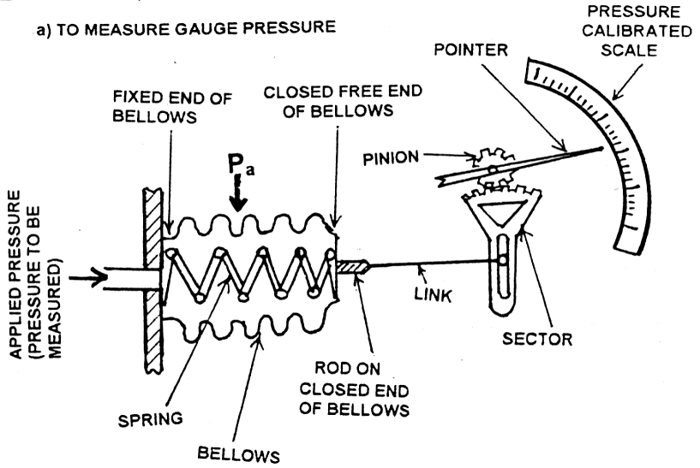

Slide 54
Bellows gauges to measure gauge pressure
Working
The pressure to be applied to the fixed open end of the bellows.
Due to the applied pressure, the Bellows expands length wise causing a linear displacement of the rod fixed at its closed free end.
This linear displacement is proportional to the applied pressure.
As the rod is connected to a link-sector-pinion arrangement, the linear displacement of the rod is magnified and converted to the rotary motion of the pinion.

Slide 55
Bellows gauges to measure gauge pressure
As the pinion rotates, it makes the pointer attached to it, to sweep over a scale calibrated, to read pressure directly.
As the pressure outside the bellows is usually atmospheric pressure and less than the applied pressure the bellows gauges reads gauge pressure

Slide 56
Bellows gauges to measure gauge pressure
Applications
They are generally used for measuring medium and low pressure.
They have wide application in low pressure measurement.
To measure gauge pressure up to 0 to 2000 PSi.
To measure vacuum pressure up to 0 to 30 inch.Hg.

Slide 57
Bellows gauges to measure gauge pressure
Advantages
Cost is less.
Simple in construction.
Disadvantages
Zero shift problems exist.
Cannot be used for higher pressure measurement.
Springs used in Bellows are difficult to design.

Slide 58
Bellows gauges to measure gauge pressure
Bellows gauge materials of construction
The choice of material depends upon pressure range and resistance to corrosion.
The following materials are used to make Bellows gauge.
Brass
Stainless steel
Phosphor Bronze
Monel
Beryllium copper.

Slide 59
Vacuum Measurement - Pirani Gauge
Principle
A conducting wire gets heated when electric current flows through it.
The rate at which heat is dissipated from this wire depends on the conductivity of the surrounding media.
The conductivity of the surrounding media intern depends on the density of the surrounding media, i.e. lower pressure of the surrounding media, lower will be its density.
If the density of the surrounding media, is low, its conductivity also will be low causing the wire to become hotter for a given current flow, and vice-versa.

Slide 60
Pirani Gauge
Construction
The pirani gauge chamber which encloses a platinum filament.
A compensating cell to minimize variation caused due to ambient temperature changes.
The pirani gauge chamber and the compensating cell are housed on a wheat stone bridge circuit as shown in Figure

Slide 61
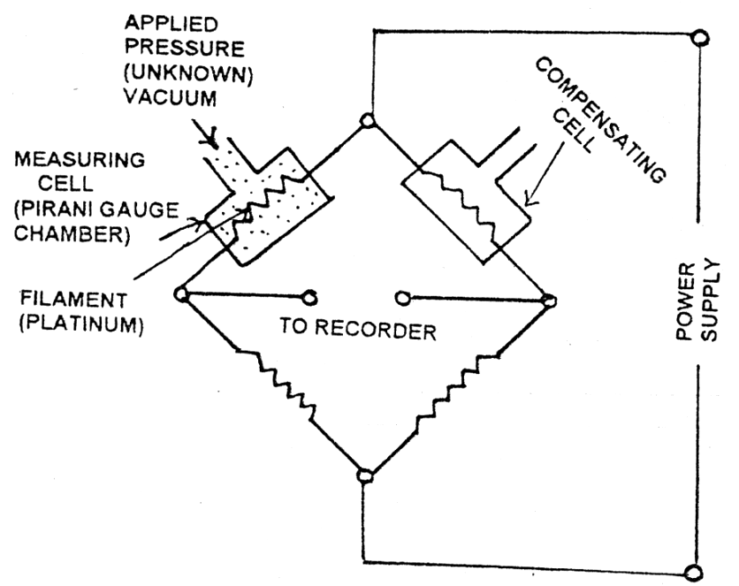

Slide 62
Pirani Gauge
Working
A constant current is passed through the filament in the pirani gauge chamber.
Due to this current, the filament gets heated and assumes a resistance which is measured using the bridge.
Now the pressure to be measured (applied pressure) is connected to the pirani gauge chamber.
Due the applied pressure, the density of the surrounding of the pirani gauge filament changes.

Slide 63
Pirani Gauge
Due to this change in density of the surrounding of the filament, its conductivity changes causing the temperature of the filament to change.
When the temperature of the filament changes, the resistance of the filament also changes.
Now the change in resistance of the filament is determined using wheat stone bridge.
This change in resistance of the pirani gauge filament becomes a measure of the applied pressure when calibrated.

Slide 64
Pirani Gauge
Applications
Used to measure low vacuum and ultra high vacuum pressure.
Used to measure gases as Argon, carbon-di-oxide, air, water vapour, helium, acetylene and hydrogen.
Useful in range 20 to 200 microns.

Slide 65
Pirani Gauge
Advantages
Simple and easy to use.
It gives accurate result.
Good response to pressure changes.
They are inexpensive.
Measurement can be taken from a distance.
Disadvantages
They must be checked frequently.
Electric power is must for its operation.
It depends on the type of gas in which the pressure is measured.

Slide 66
Ionisation Gauge
Principle
Electrons emitted at the hot cathode by thermonic emission are attracted toward the grid, pass through the grid, and start toward the plate.
Ions are formed by the collision of the electrons with molecules of the gas present in the tube.
These positive ions are collected on the plate, and, as a result, a positive ion current exists.
The amount of ion current is proportional to the amount of gas present, provided the electron current is constant.

Slide 67
Ionisation Gauge
Construction and working
The ionization gauge (thermonic type) is shown in the figure.
The tube is directly connected to the point of pressure measurement.
The tube is in the form of a triode with cathode, grid and plate.

Slide 68
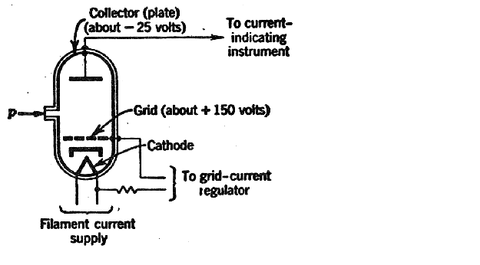

Slide 69
Ionisation Gauge
The grid is maintained at high positive potential with respect to the cathode while the plate is held at a negative potential with respect to the grid.
The pressure to be measured is connected to the tube.
The grid draw electrons from the cathode and these electrons collide with the gas molecules, thereby causing ionization of the gas molecules.
These positive ions are collected on the plate, and, as a result, a positive ion current exists.

Slide 70
Ionisation Gauge
The electrons return to the grid and are collected, and the flow of electrons is maintained constant by a grid-current regulator.
The ion current is measured by an instrument similar to the automatic-balance potentiometer.
The amount of ion current is proportional to the amount of gas present, provided the electron current is constant.
The measurement of this current becomes a measure of the applied gas pressure.

Slide 71
Ionisation Gauge
Applications
It is used to measure absolute pressure above 2 microns.
Used to measure low vacuum and ultra high vacuum pressure.
Used to measure, low pressure continuously.

Slide 72
Ionisation Gauge
Advantages
Measurement can be taken from a distance
Fast response.
Have good sensitivity.
Disadvantages
The grid burns out quickly.

